Slide 1


Roomeo
Usability Testing Report
Guided by Design, Driven by Results.
By
Anna Presutti, Tenley Lubash, Jake Christianson, and Xiaowen Ju

Slide 2
Table of Contents
Executive Summary 03
Introduction 04
Methodology 06
Task One Findings 12
Task Two Findings 13
Task Three Findings 14
Task Four Findings 15
Recommendations 18
Next Steps 19

Slide 3
Executive Summary
This report summarizes the findings from user testing conducted on our app, Roomeo. We carried out both moderated and unmoderated testing to gather a broad range of insights. In total, we completed four moderated tests, along with two unmoderated tests through Userology and five through UserTesting. This combination provided substantial data and valuable feedback for improving our app.
Overall, the most significant takeaway was that users would genuinely use Roomeo and found clear value in its purpose. An encouraging result for our team as we work to create a useful and relevant product. Additionally, testing revealed opportunities to clarify certain wording within the app and to improve the visibility of interactive elements. This was especially notable within the chore-tracking feature, where users indicated that clickable sections could be made more intuitive to support a smoother flow.
These insights offer actionable direction for refining Roomeo and enhancing the overall user experience.

Slide 4
Introduction
Roommates often struggle with managing shared spaces, dividing chores, and handling financial responsibilities like rent and utilities. These challenges can lead to tension, miscommunication, and frustration in the household.
While there are apps designed for budgeting or task management individually, there is currently no unified solution that supports both shared expenses and household responsibilities in one place. Our project proposes a single platform that combines task distribution, expense tracking, and communication tools to help roommates manage responsibilities collaboratively and reduce conflict.
This design is especially impactful for students and young adults balancing academics, work, and social lives. It provides a structured yet flexible system to support a more organized, fair, and harmonious living environment.

Slide 5

Objectives
See payment details
Be able to view what each roommate owes for each type of payment needed in their apartment
Resolve conflicts
Use AI to work out conflict and to keep a healthy living space
Balance chore tasks
Divide the chores among the roommates equally and rotating chores after a certain type has passed (i.e. couple days, week, month, etc)

Slide 6

Methodology
Moderated Usability Testing
Conducted live with a facilitator.
Allowed real-time observation, probing questions, and clarification.
Helped identify deeper reasoning behind user actions.
Unmoderated Usability Testing
Participants completed tasks independently using a scripted testing flow.
Collected quantitative metrics (task time, success rate, error rate).
Revealed natural, unassisted user behavior.
Why Both?
Moderated tests provided rich qualitative insights.
Unmoderated tests provided scalable, objective performance data.
Together, they offered a well-rounded understanding of usability issues in Roomeo.
*Both the moderated Zoom sessions and the unmoderated UserTesting sessions evaluated the same three core tasks to ensure consistent comparison.

Slide 7

Step 1 Warm-up questions
We asked each participant a set of warm-up questions, like age, amount of roommates, and if they use any apps already for their apartment.
Step 2: Conduct task & follow-up questions
Moderated Testing Overview
Participants were asked to perform one of the tasks and after each task they were given questions related to the task. For example how hard was the task, or if anything confused them.
Step 3: Post session interview
At the end of the session, we asked the participant a couple of questions about the overall features of the app, design, features they would add, features they didn’t like, etc.)

Slide 8
Unmoderated Testing Overview
Participants completed tasks independently using a scripted flow
Captured natural navigation patterns without moderator guidance
Collected quantitative metrics (task time, success rate, errors)
Highlighted labeling issues, unclear icons, and non-responsive features
Showed how well users understood the interface based only on visual cues
Provided objective performance data to balance qualitative insights from moderated testing

Slide 9
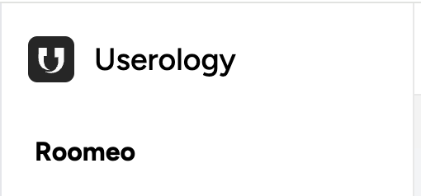
Unmoderated Testing
Links
UserTesting
Userology.co

Slide 10
Platform Comparison
UserTesting
Userology
Participants complete tasks on their own
Browser extensions enable screen capture
Provides detailed transcripts of recordings
More manual steps (reviewing videos and transcripts)
Good for structured, performance-focused UX metrics
Supports embedding Figma prototypes
Live AI moderator guides both the task and interview
High automation: AI synthesizes insights
Minimal manual review needed
Good for rapid qualitative insight generation

Slide 11


Tasks and Scenarios
View Rent Breakdown
Check Off Dishes in the Chore Wheel
Add a New Chore to the Chore Wheel
View the Monthly Summary of All Information

Slide 12


Task 1: View Rent Breakdown
Smooth Navigation
Design Pitfalls
Thoughtful layout
Users quickly recognized the money icon
Easy to locate the rent breakdown
Some uncertainty about how to notify roommates
A few users hesitated before selecting the correct tab
Rent breakdown was readable and easy to interpret
Users understood each roommate’s amount without difficulty

Slide 13


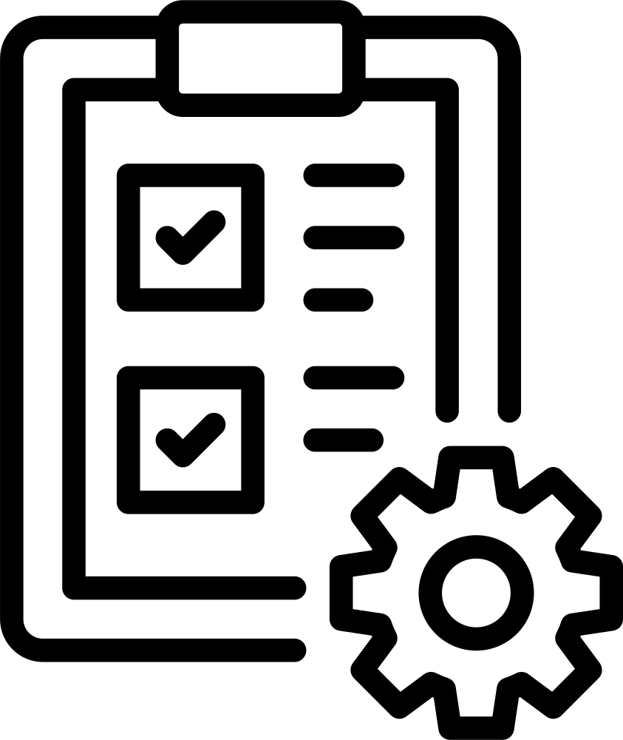
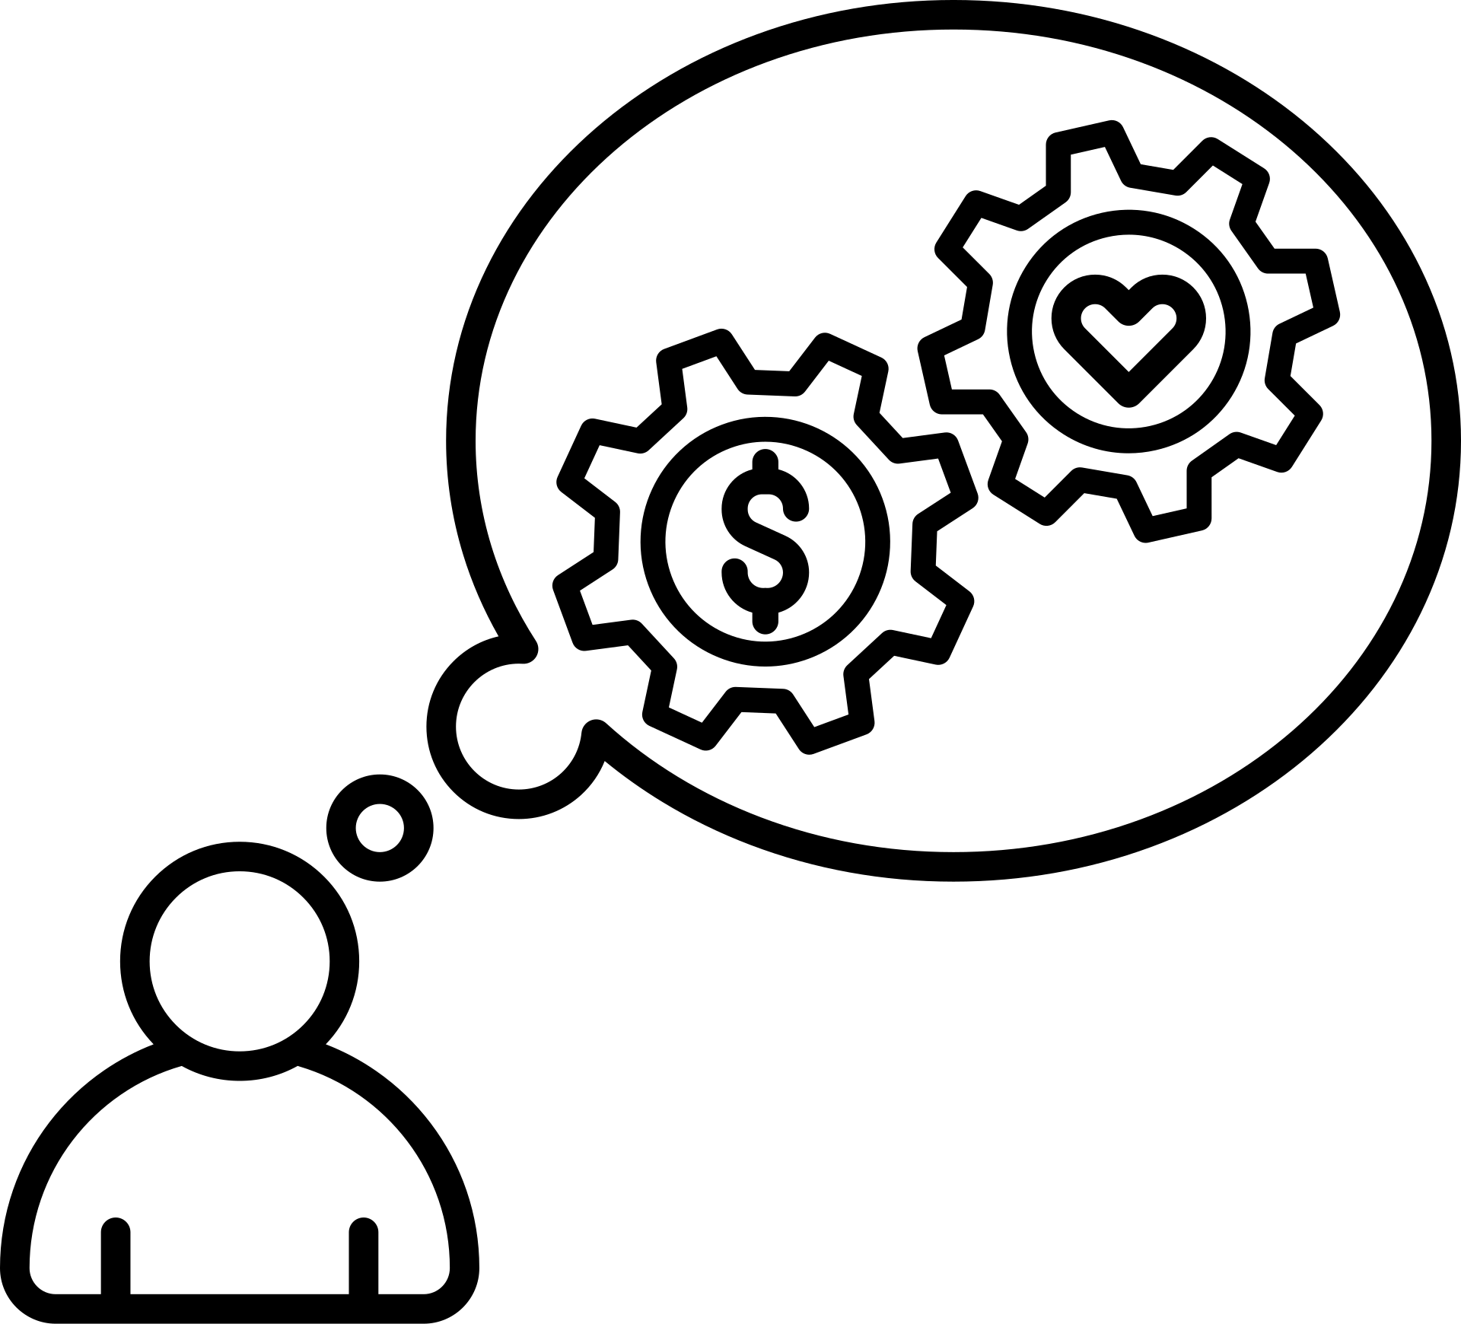
Task 2: Check Off Dishes
Clear Status Indicators
Users instantly understood the checkboxes
Marking a chore “done” felt easy and obvious
Smooth Task Completion
Most participants located the chore list quickly
Task was completed with little hesitation
Expectation Gaps
Some users expected to edit chore details
“Customize” button didn’t match what users thought it would do

Slide 14
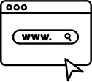

Task 3: Add a New Chore
Interaction Issues
System Feedback Gaps
User Expectations
Users clicked Customize and Add More, but nothing occurred
Repeated attempts led to confusion about whether the task was possible
No confirmation or visual response to user actions
Participants assumed the feature was incomplete
Users expected a clear Add Chore option
“Customize” did not match user expectations

Slide 15


Task 4: View Monthly Summary
Navigation
Information Clarity
Minor Confusion
Most users selected the chart/graph icon quickly
Even uncertain users still reached the correct screen
Summary data was easy to read and understand
Users described the layout as clean and organized
Some hesitation about the icon meaning
Did not affect task completion or accuracy

Slide 16
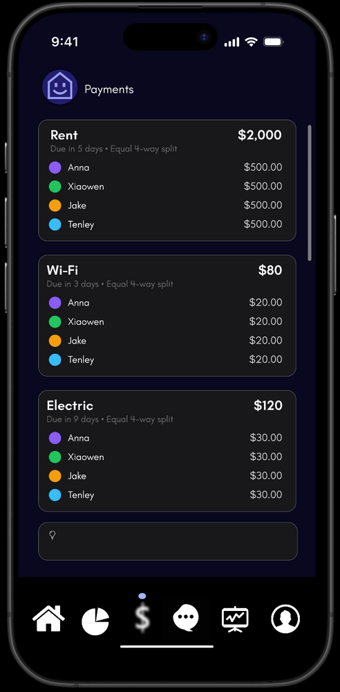
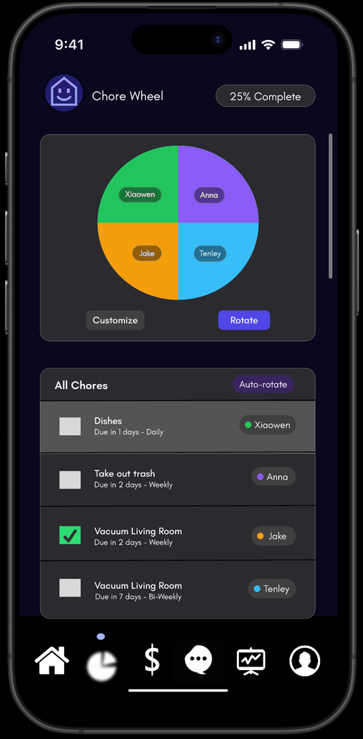
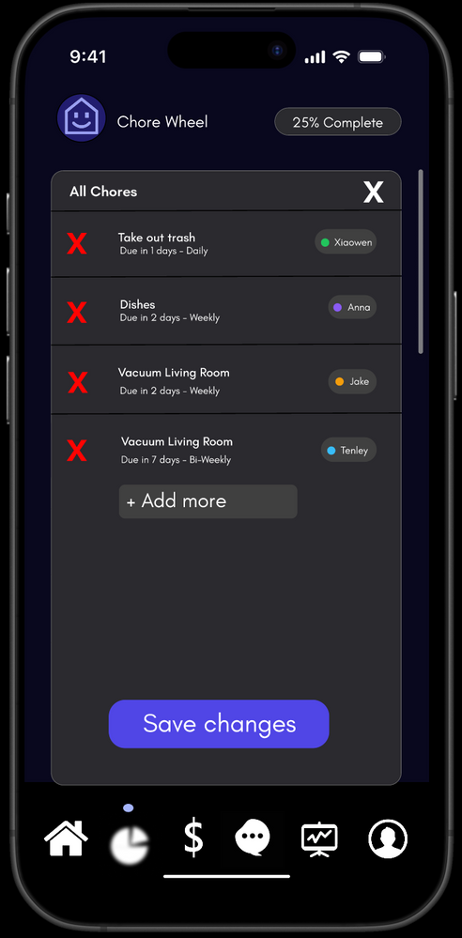
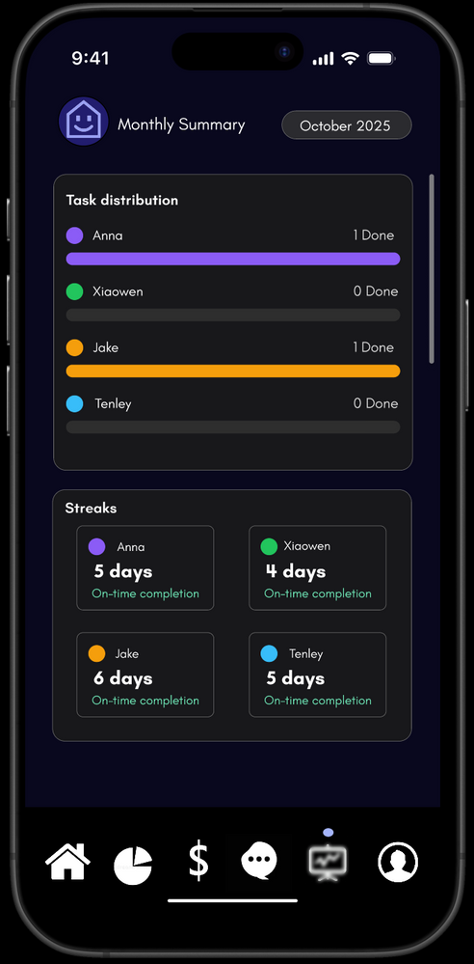
Task Visual References
Task 1
Task 2
Task 3
Task 4

Slide 17
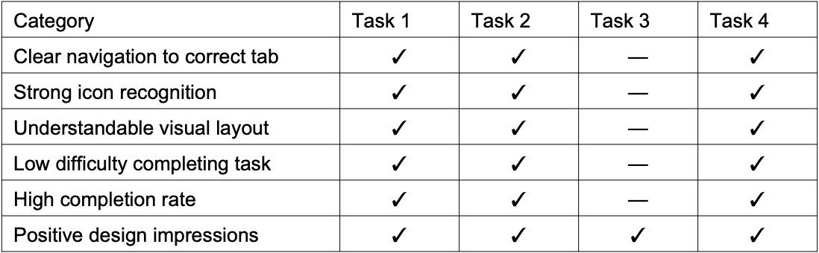
Finding Summary Positives

Slide 18
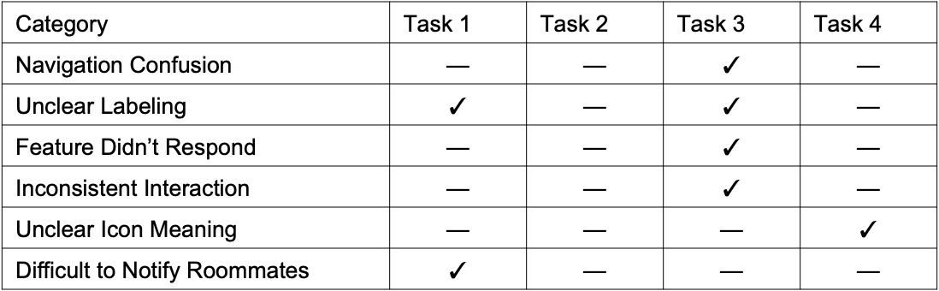
Finding Summary Negatives

Slide 19
Recommendations Summary
Enhance Interaction Design
Introduce a dedicated Add Chore call to action button to reduce ambiguity
Provide immediate interaction feedback (success, error, state change, etc.)
Strengthen Navigation & Information Architecture
Refine icon labeling to improve information scent
Add a clear return path to reinforce wayfinding and reduce disorientation
Improve System Feedback & Visibility
Surface subtle status indicators to confirm completed actions
Differentiate interactive vs. static elements to improve affordance clarity
Support Error Prevention
Reduce ambiguous touch targets to minimize mis-taps and false interactions
Provide guardrails or hints when a user enters a non-functional or incomplete flow

Slide 20
Next Steps
Moving forward, we gained several valuable insights that will shape the final version of our app. One key takeaway is the importance of ensuring the app is clear and usable for all users, not just those familiar with technology.
We also realized that when asking users to complete tasks, we need to either design flows that are fully functional or clearly communicate when features are only partially implemented. This caused confusion during unmoderated testing since we weren’t present to clarify prototype limitations.
These insights will guide how we structure future tests and how we refine the app as we move toward final development. Overall, the feedback from both testing methods was extremely valuable, and we look forward to applying it in the next iteration.

